Slide 1
Architectural Design DFD/ER diagram/Process Flow diagram

Slide 2
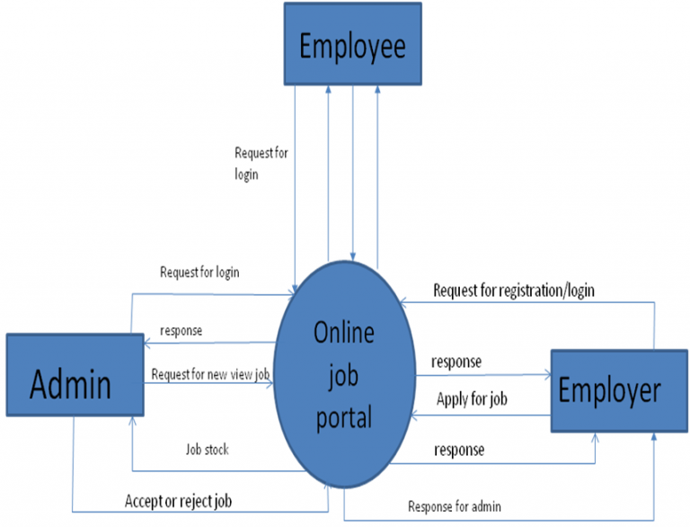
Data Flow Diagram-Level 0 (Sample)

Slide 3
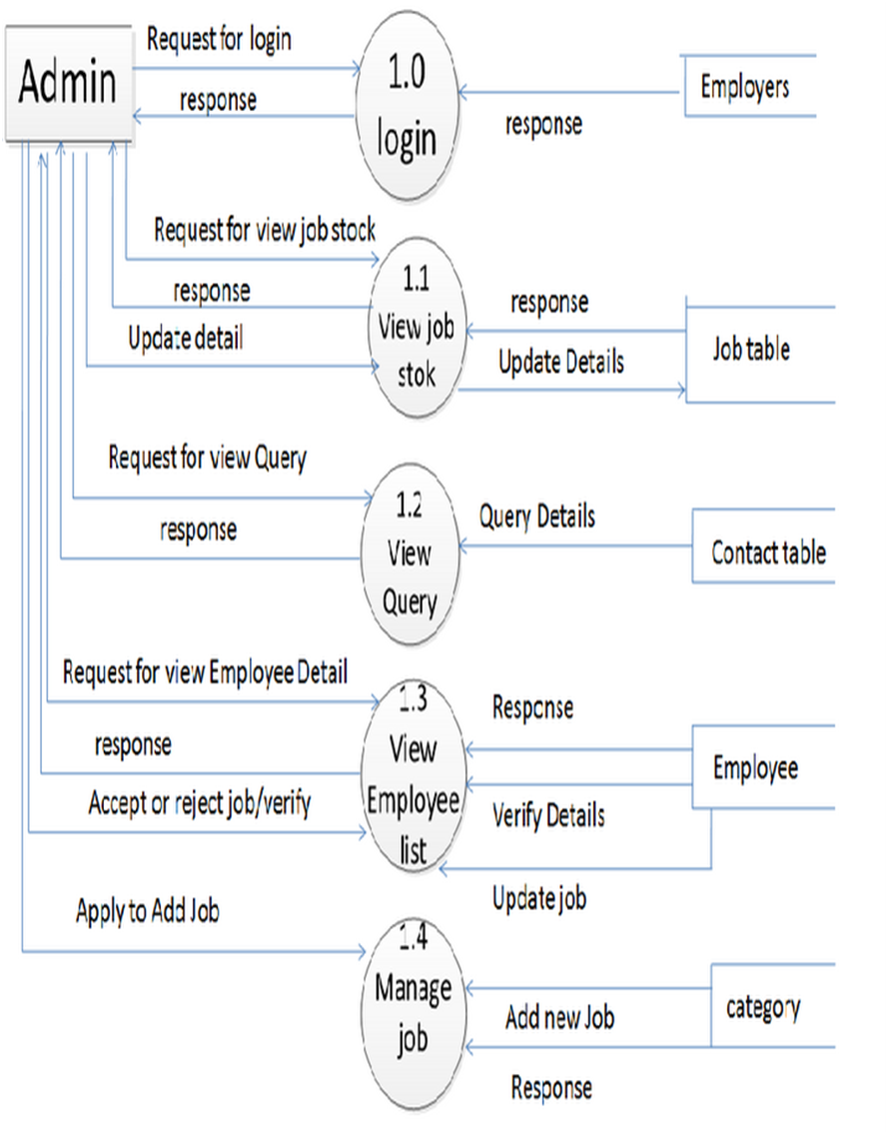
Data Flow Diagram-Level 1 (Sample)

Slide 4
Module Split-up
Module 1:
Employer and Seeker Login Module 2:
Admin panel Module 3:
Job Posting and applying, quiz page. Module 4:
Email and Content Management
Module 5:
User Settings

